Slide 1
A Digital Prescription Android App For Interface Between Doctor And Patient
Prashant Rathod - C 20
Vivek Rugale - C 24
Pratik Sathwane - C 32
Guide : Prof. Praveen Pol

Slide 2
Objective
It's very hard for old patients to remember the medications they have been prescribed by the doctor.
Forgetting certain medicines or missing their timing can lead to medical emergencies.
Our objective is to develop a mobile application where the doctor should be able to upload his prescription digitally to our app and it will be visible to the respective patient.
The app will also give a notification or alarm at the time of the respective medicines as per the prescription.

Slide 3
Problem Statement
People have a habit to forget the medicines or miss the proper timings in their busy lifestyle.
Mostly the older patients have various kinds of medicines which they have to take on daily basis. But they can’t remember their medications which is very important for them.
A mobile app can remind the timings of medicines for such patients as people are constantly in contact with their phone.

Slide 4
Literature Review
https://blog.capterra.com/top-7-medical-apps-for-doctors/
https://www.mycareindia.co.in/
https://www.onlinemedicalcare.org/15-best-online-medical-apps-that-make-personal-health-easier/

Slide 5
Technology
Domain -
Healthcare
Softwares -
Android Studio

Slide 6
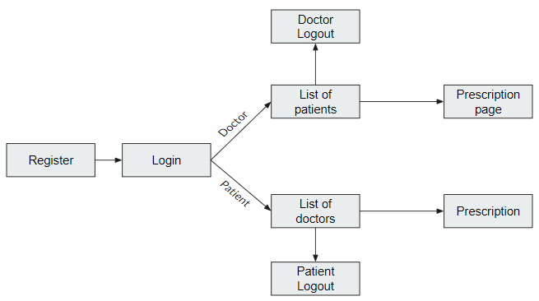
Workflow

Slide 7
References
http://developer.android.com/
https://firebase.google.com/docs/rules
https://stackoverflow.com/
https://reactnative.dev/

Slide 8
Thank You

